Slide 1
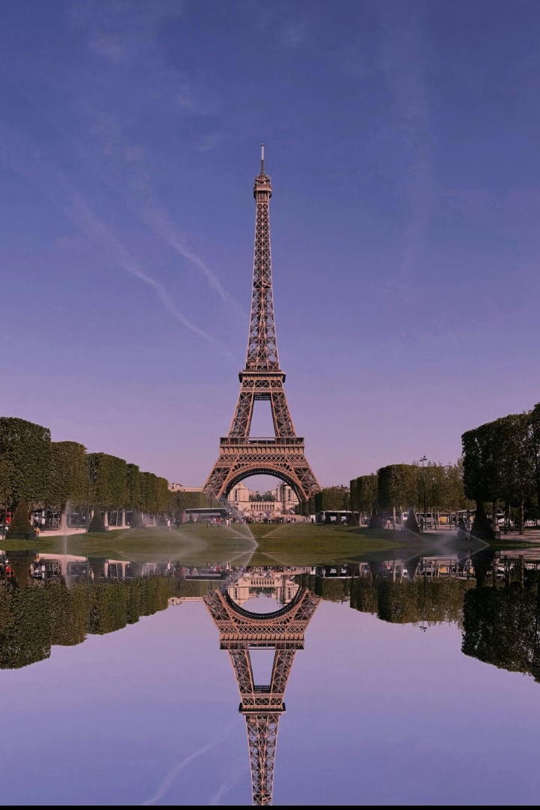
Gemini Landmark Description App
Enhances tourist experiences with AI. Provides instant, AI-generated information about iconic landmarks. Multilingual support and accessibility features make exploring cultural heritage sites easy and inclusive for travelers worldwide.

Slide 2
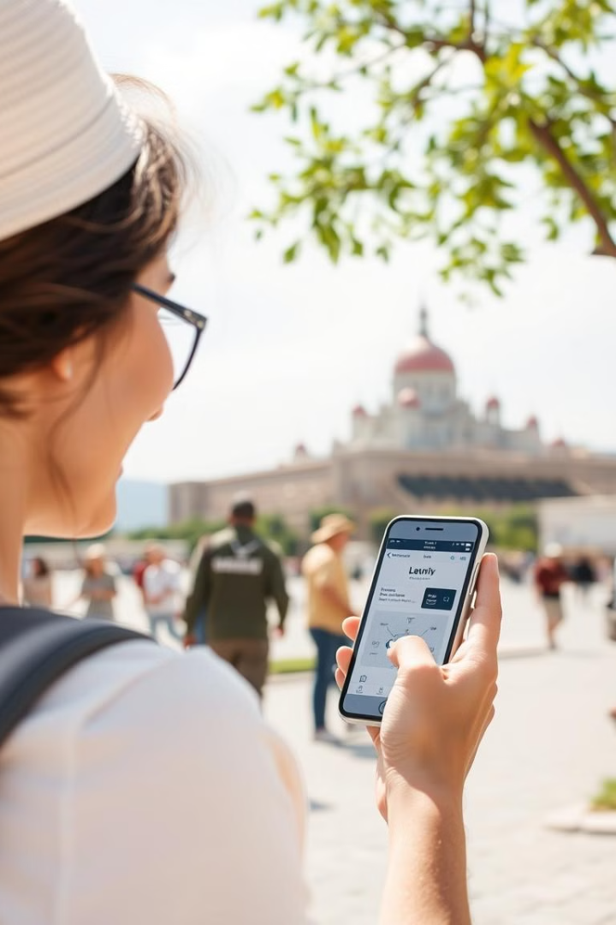
Gemini Landmark Description App Overview
1
Engaging Content
2
Real-Time Information
Makes exploring new places engaging and informative.
Guides tourists with relevant, real-time landmark information.
3
Target Audience
4
Interactive Maps
Designed for tourists, travelers, and local explorers.
Helps users navigate between different landmarks efficiently.

Slide 3

Feasibility Assessment
Technical
Operational
Economic
Built with HTML, CSS, JavaScript, and Node.js for broad device compatibility. Utilizes APIs for landmark data and image recognition, with a scalable architecture to handle growing user traffic. Includes weather forecasts, nearby restaurants, hotels, and more.
User-friendly design for tourists of all ages. Easy navigation with intuitive interface elements. Provides access to essential information and maps. It is multilingual and has audio guide option.
Low cost for static version with minimal server requirements. Potential for monetization through premium features or partnerships. Reduces dependency on costly traditional tour guides.

Slide 4
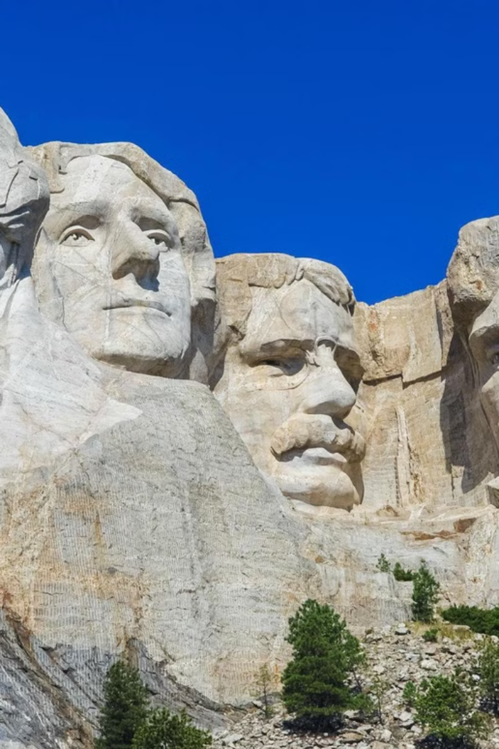






AI's Transformative Benefits in Tourism
Enhanced Personalization
Increased Efficiency
Cost-Effective Solutions
Instant access to travel information.
AI customizes travel experiences.
Minimizes need for human guides.
Improved Customer Satisfaction
Sustainable Tourism
Accessibility
AI-driven tour guides can reduce reliance on traditional guides, promoting more sustainable tourism by lowering the environmental impact of group tours
AI's ability to personalize recommendations can enhance the overall travel experience and satisfaction of users.
With instant access to information and tailored suggestions, travelers can plan their trips more efficiently and effectively.

Slide 5
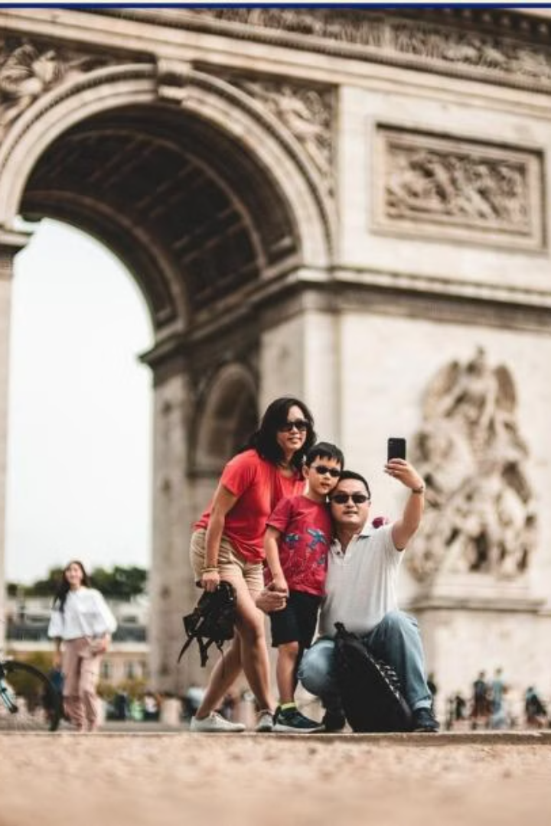
Key Features & Insights
AI-Driven Experience
Real-Time Information
Comprehensive and immersive tourist experience.
Personalized insights enhance engagement.
User-Centric Design
Fosters interaction and community.
Environmental Impact
By optimizing travel routes and suggesting eco-friendly accommodations, AI contributes to promoting sustainable tourism practices.

Slide 6
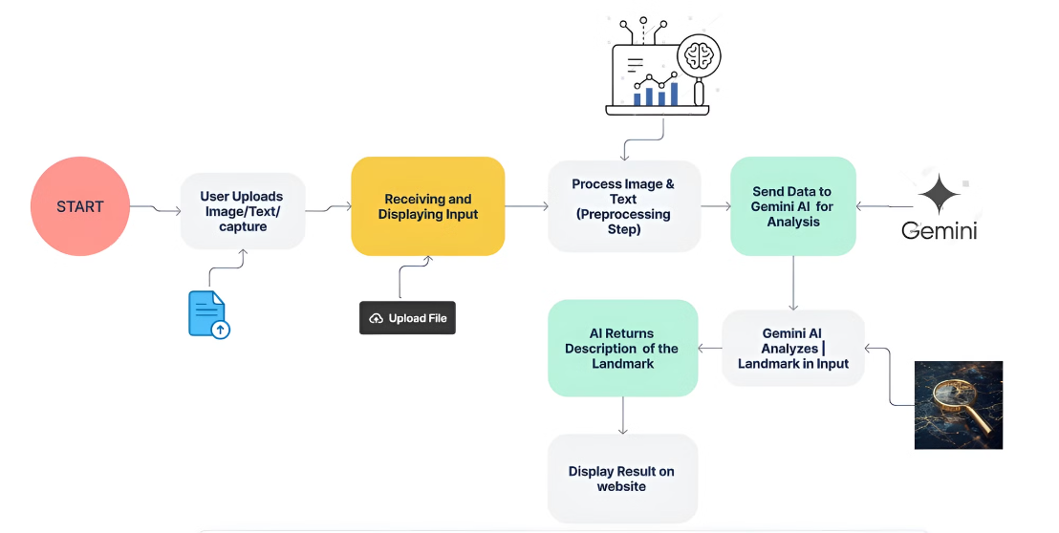
WORK FLOW

Slide 7

Experience the Future of Travel
Enhance your journey with the Gemini Landmark Description App. Discover how AI can transform your travel today.
THANK YOU -TEAM TITAN MINDS
AKSHITHA REDDY.S
AMRUTA KAJULURI
SANJANA.D
SHREYA.B
SANDEEP.G

